Slide 1
Intercity Bus Reservation System
Team No: 30
Student Name: G. Sneha | Roll No: 2620080111
Student Name: L. Akshitha | Roll No: 2620080026

Slide 2
Abstract
The Intercity Bus Reservation System is a Java-based application designed to simplify bus ticket reservation. It allows users to search for buses, choose a suitable route and travel date, view available seats, book a seat, and cancel an existing reservation. A seat map helps passengers identify available and booked seats and prevents double booking. The menu-driven system uses switch for menu options, if-else for seat availability, a for loop to display the seat map, and a while loop to continue until the user exits. The project demonstrates Java programming concepts in a real-world application and provides a basic, structured approach to intercity bus reservations.
Project: Intercity Bus Reservation System
Subject: Problem Solving Using Programming (Java) | Academic Year: 2026–27
Department: FED | Faculty: Dr. Gopikrishna Vellaturi
Project Batch: KLH/PSPJAVA/Section-8/Batch-30

Slide 3
Understanding Problem Statement
Problem: Manual bus booking can make it difficult to check routes, track seat availability, and manage cancellations.
Goal: Build a simple, menu-driven Java application for searching trips, viewing seats, booking and cancelling reservations.
Key requirements: prevent double booking; update seat status after booking/cancellation; show clear messages; allow repeated operations until Exit.
Expected result: a clear and organized reservation flow with saved booking records.

Slide 4
CO 1 — Java Foundations & Problem Solving
Algorithm and flowchart: define inputs, process and outputs before coding.
Variables and data types: represent passenger names, route names, seat numbers and booking status.
Scanner input and console output: accept menu choices and display booking details.
One-line link to project: Java foundations capture passenger choices and represent each trip and reservation.

Slide 5
CO 2 — Control Flow
if–else: check whether a selected seat is available or already booked.
switch: select Search, View Seats, Book, Cancel or Exit from the main menu.
for loop: display all seats in the seat map.
while loop: repeat the menu until the user chooses Exit; break/continue can control menu flow.
One-line link to project: control statements guide the booking process and prevent invalid seat selection.

Slide 6
CO 3 — Recursion & Arrays
1D arrays: store seat status for a bus trip using seat indices.
Array traversal: loop through seats to display availability and count booked seats.
2D arrays: represent seats as rows and columns when a visual seat layout is needed.
Recursion: a small recursive helper can demonstrate a recursive count/search, with a base case.
One-line link to project: arrays represent and update the seat map efficiently.

Slide 7
CO 4 — Inheritance & Polymorphism
Inheritance: a BusTrip class can extend a general Trip class and reuse route/date details.
Method overriding: a bus trip can provide its own trip-details display method.
Polymorphism: a Trip reference can call the overridden method on a BusTrip object.
Interfaces: a ReservationActions interface can define bookSeat() and cancelSeat() operations.
One-line link to project: OOP separates trip details from reservation behaviour and encourages code reuse.

Slide 8
CO 5 — Java File I/O (NIO.2)
Path and Files: identify and manage the reservation data file.
Files.writeString / Files.readString: save and reload booking records.
Append mode: add new reservation/cancellation records without replacing earlier records.
Exception handling: handle missing files and file-access errors safely.
One-line link to project: file handling keeps booking records available after the program closes.

Slide 9
CO 6 — Collections, Generics & Streams
ArrayList: keep a resizable list of trips or reservation records.
HashMap: map seat numbers to passenger/reservation details for quick lookup.
Generics: use typed collections such as List<Reservation> to reduce type errors.
Streams: filter and count booked reservations; collect results for a summary report.
One-line link to project: collections organize bookings, while streams help generate reservation summaries.

Slide 10
Conclusion
The project turns bus reservation steps into a simple menu-driven Java application.
CO1 supports problem analysis, data types and user input; CO2 manages decisions and repeated operations.
CO3 represents seats with arrays; CO4 models trips and reservation actions using OOP.
CO5 saves and reloads reservation records; CO6 organizes records with collections and stream-based summaries.
Overall, the project demonstrates how the six module areas can work together in one practical application.

Slide 11
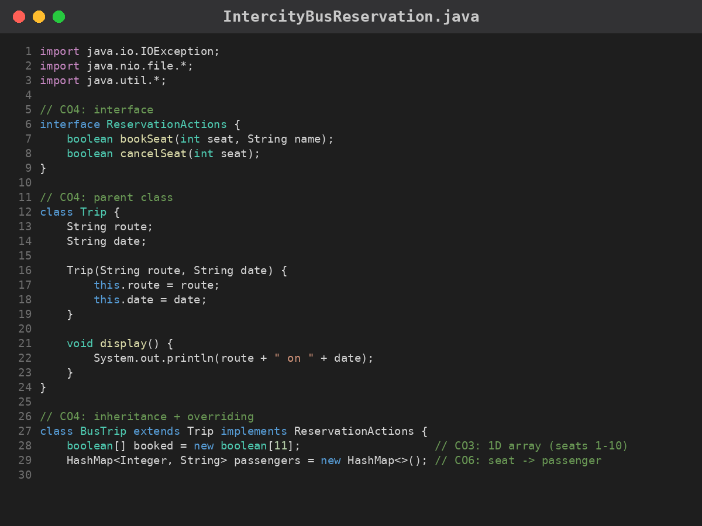
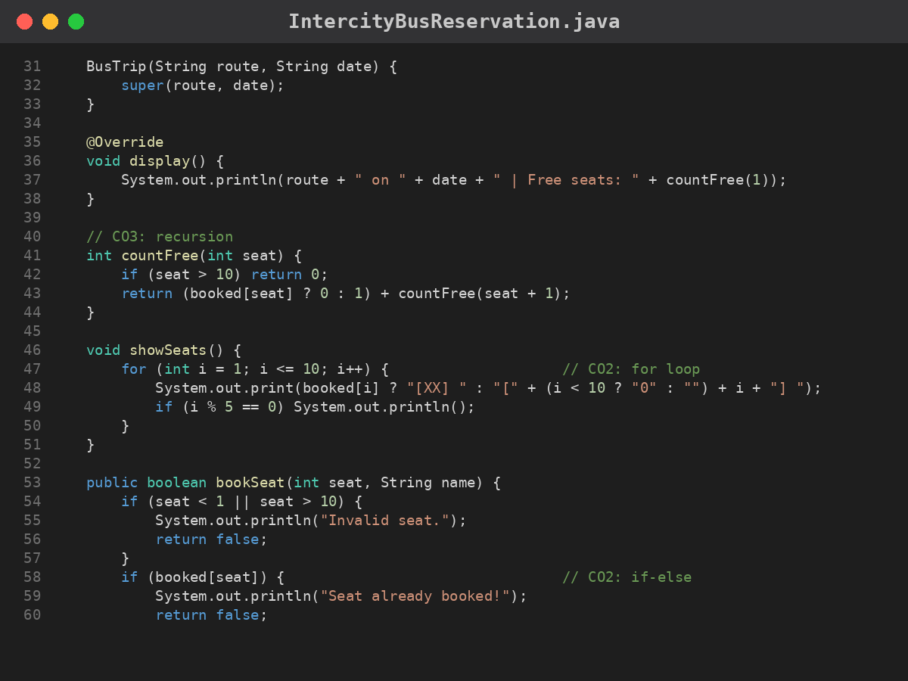
Screenshots — Source Code (1/3)

Slide 12
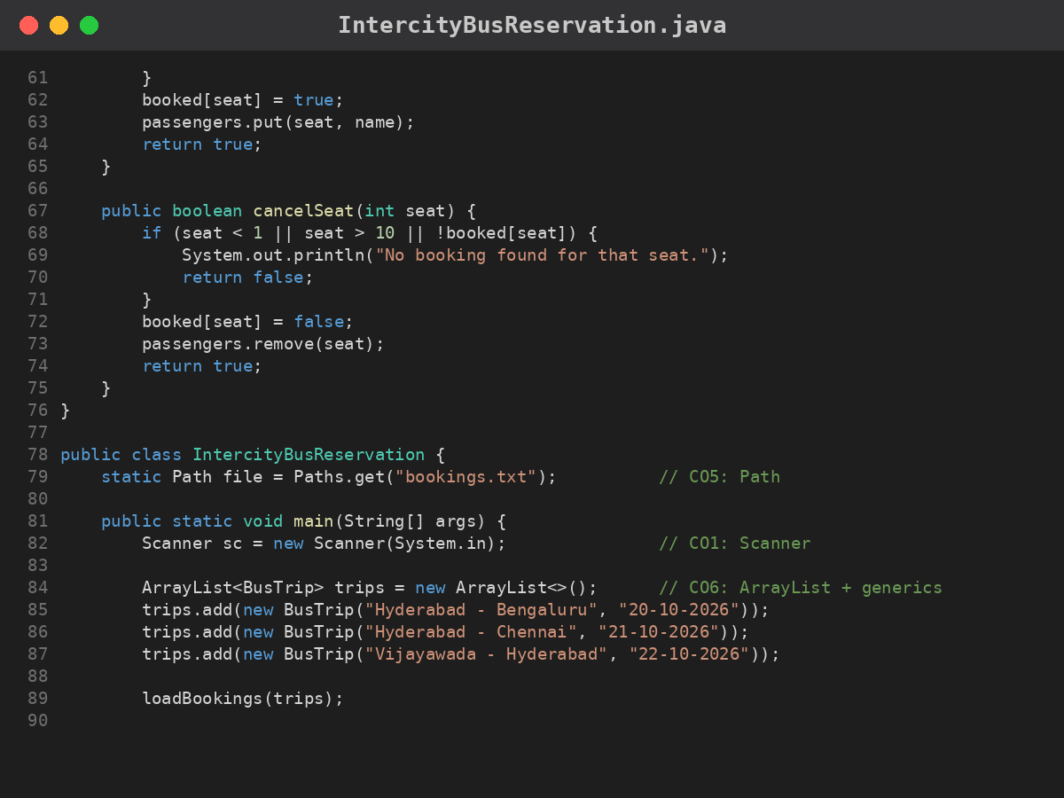
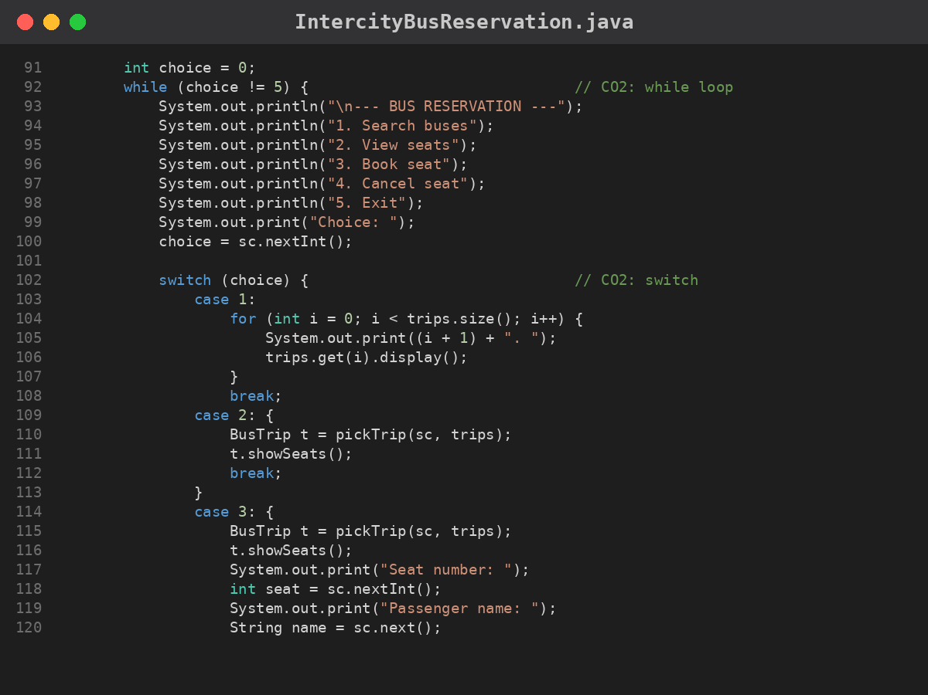
Screenshots — Source Code (2/3)

Slide 13
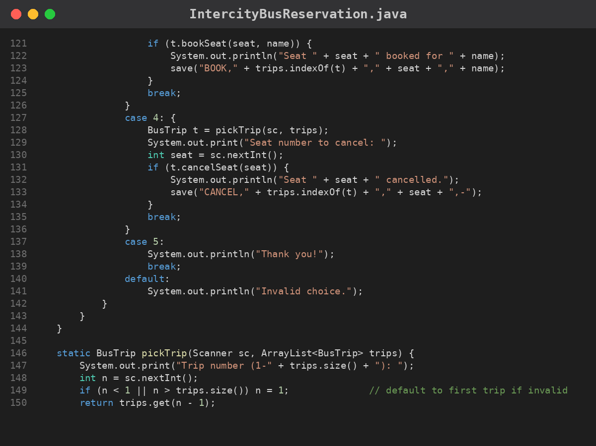
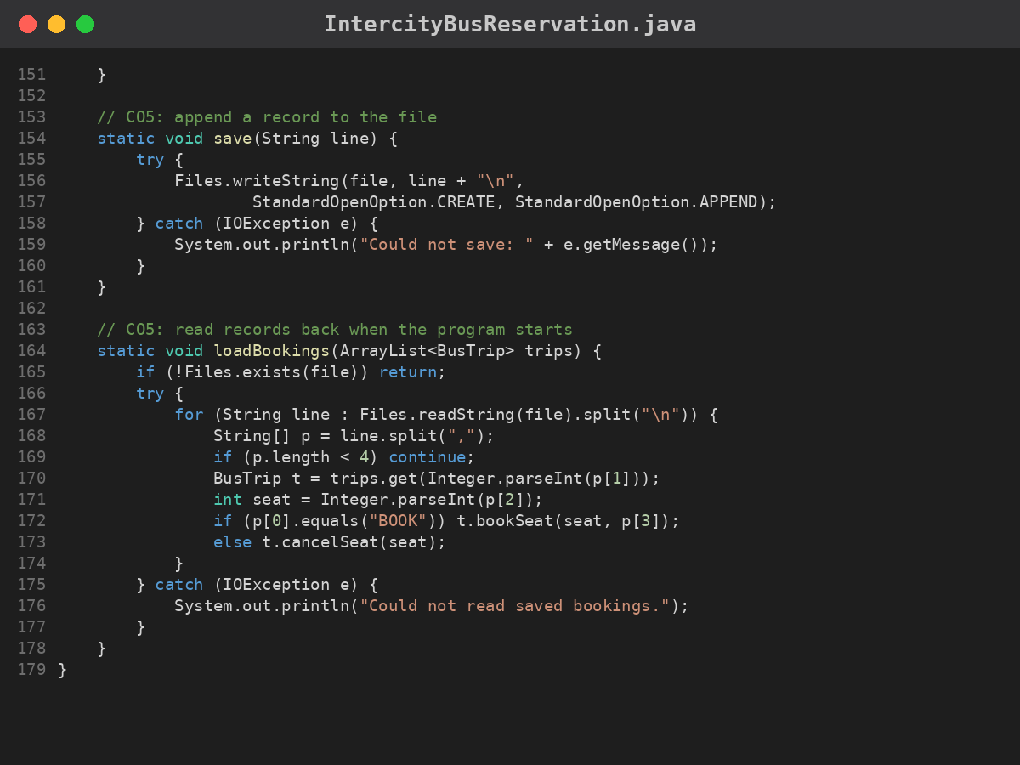
Screenshots — Source Code (3/3)

Slide 14
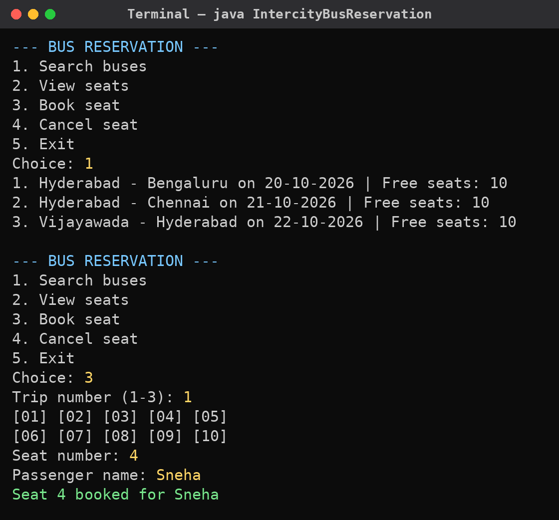
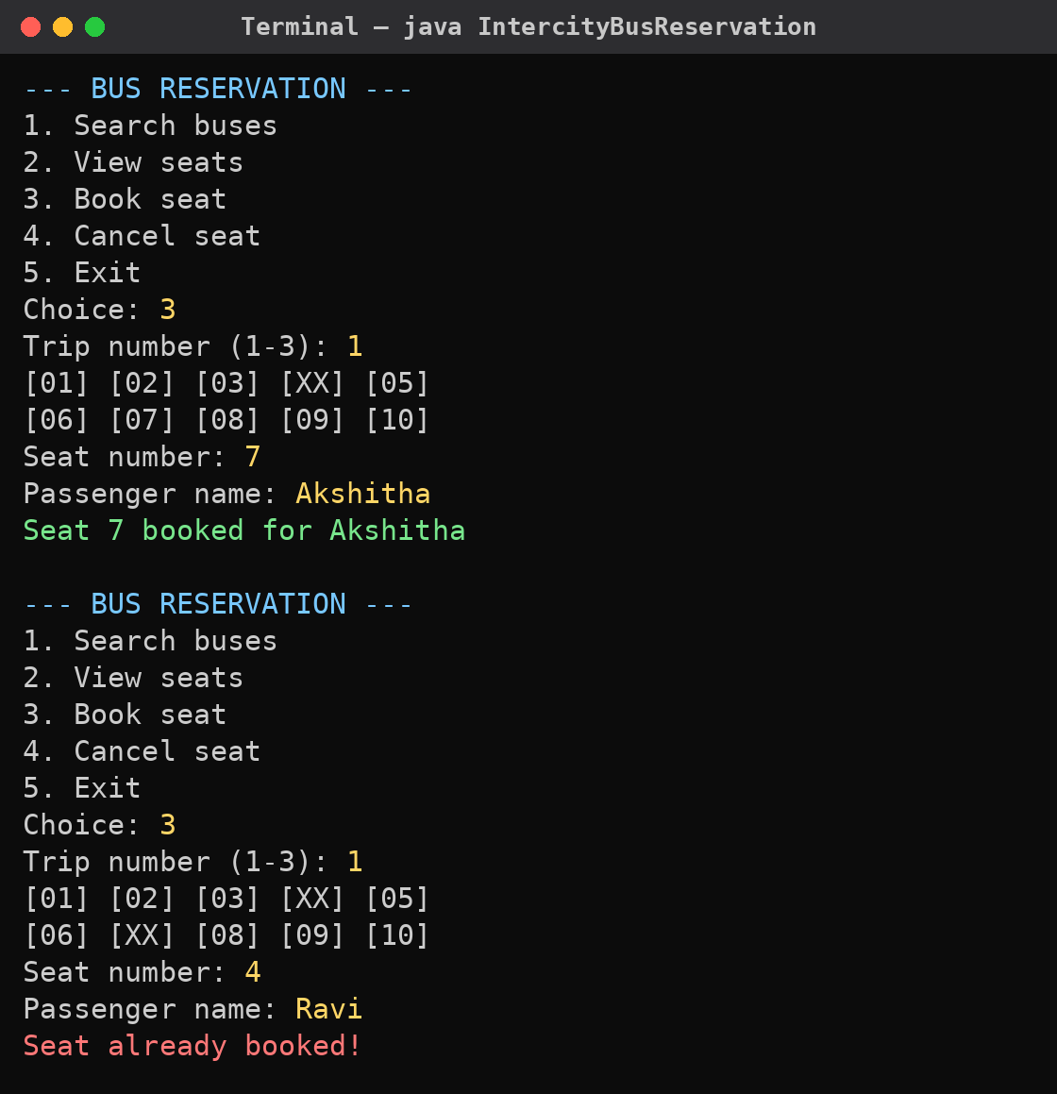
Screenshots — Program Output (1/2)

Slide 15
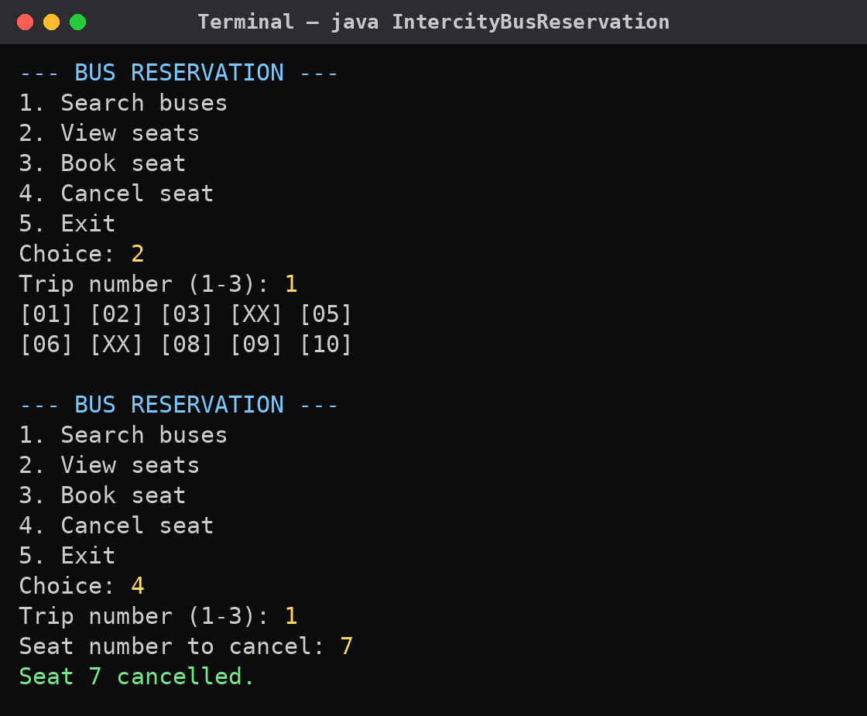
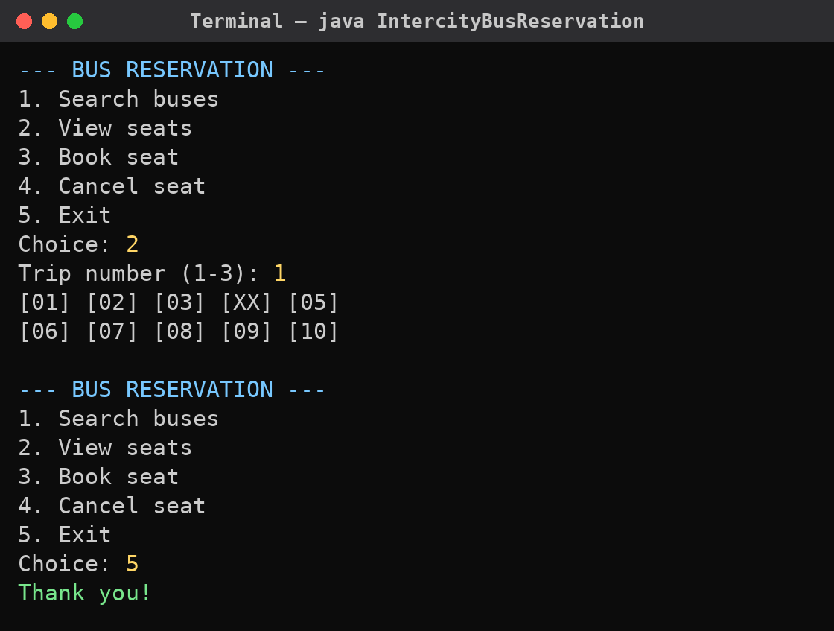
Screenshots — Program Output (2/2)

